Slide 1
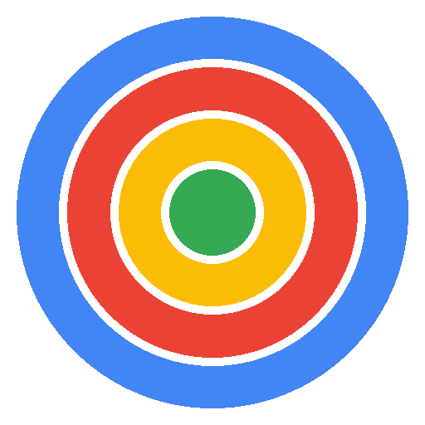
Specialist Focus
Dental & Aesthetics PPC
Driving Patient Acquisition
Direct experience managing campaigns for dental clinics and cosmetic practices
16 Years
100+
£50M+
Dental by Design | Prodent Group
Hands-On Google Ads
Accounts Managed
Total Spend
Christopher Hoole
Google Ads Specialist | April 2026
christopherhoole.com
Performance Marketing Specialist | Interview Presentation

Slide 2
Your Competitive Advantage
About Dental by Design
You have assets most competitors don't — let me turn them into patients.
Integrated Model
You control the entire chain — quality AND pricing. No other London dental clinic can say this. In PPC, this means ad copy that competitors simply cannot match.
Clinic + Lab + Manufacturer
“Up to 60% Less”
This is the most powerful ad copy hook in your market. Price-sensitive patients searching for implants will click — and your quality keeps them. This messaging should be in every headline.
Transparent Pricing Advantage
Vivo Bridge — 48 Hours
“Permanent teeth in 48 hours” is an incredible USP. Speed + quality + price = unbeatable value proposition. This is your premium product and it deserves its own campaign.
Permanent Teeth, Fast
4.8★
£1,695+
UK Network
399+ Google Reviews
Single Implant (from)
Flagship + Partner Clinics
Christopher Hoole | christopherhoole.com | Confidential
2

Slide 3
The Problem I Solve
Why You're Hiring
Every dental clinic I've worked with has the same three problems.
Wasted Spend on Irrelevant Clicks
42.7%
Without proper negative keyword management, dental implant campaigns attract searches for DIY guides, dental jobs, dental tourism, and NHS alternatives. In my last audit, 42.7% of budget was going to non-converting traffic.
Average Waste I Find
No Target CPA Guardrails
£35→£65
When bid strategies run without a target CPA, the algorithm has permission to spend anything per lead. CPAs spike from £30 one week to £65 the next. Setting the right guardrails gives you predictable, controllable costs.
Typical CPA Volatility
Lead Quality Issues
3x
Not all form fills are real patients. When conversion tracking counts email clicks or irrelevant actions as leads, the algorithm optimises for the wrong thing. Clean tracking = better algorithm decisions = more real patient enquiries.
Quality Improvement
These are the three things I fix first. Every time. The methodology is proven.
Christopher Hoole | christopherhoole.com | Confidential
3

Slide 4
Case Study — The Proof
Anonymised Client
A UK professional services business — the exact methodology I would apply to your account
42.7%
35-48%
Week 1
Of Budget Wasted
CPA Reduction
Delivery
Identified in first audit — £7,836 of £18,338 spent on non-converting traffic
Target CPA brought down from £38 to £20-25 through structured optimization
Full audit report with findings, quick wins, and restructure plan — delivered in 5 days
This is exactly the audit I would run on your account in week 1.
Christopher Hoole | christopherhoole.com | Confidential
4

Slide 5
Dental & Aesthetics Experience
Sector Experience
Direct experience in the same market dynamics as Dental by Design
Cosmetic Dental Clinic
Medizen Aesthetics
via PodDigital Agency
Birmingham — medically-led cosmetic clinic
Google Ads for implants, veneers, and cosmetic dental treatments
Competitive local market with CPCs of £5-15+
Confidential — active agency client (can discuss approach in conversation)
Injectable treatments, laser procedures, aesthetic services
High-value patient leads in a competitive B2C market
CPA reduction through audience and landing page optimization
Same Patient Journey
Same Cost Dynamics
Same Success Metrics
Search intent → ad click → landing page → enquiry → booking.
High CPCs, long decision cycle, price-sensitive patients.
Patient bookings, not clicks. Quality over volume.
Christopher Hoole | christopherhoole.com | Confidential
5

Slide 6
Week 1 Plan
First 5 Days
Days 1-2
Days 3-4
Day 5
Full Account Audit
Competitive Analysis
Quick Wins Live
Google Ads + Meta account structure deep-dive
Bid strategies, conversion tracking, Quality Scores
Benchmark CPL, CPA, conversion rates per clinic
Competitor bidding — keywords, ad copy, landing pages
Gaps in the dental implant keyword space
Your USP positioning vs the competition
Fix conversion tracking issues
Add negative keywords to block waste
Set target CPA / ROAS guardrails
Full audit report with findings and 90-day roadmap by Friday.
Christopher Hoole | christopherhoole.com | Confidential
6

Slide 7
90-Day Roadmap
Months 1-3
20-30% CPL Reduction
Within 90 days, based on experience with similar dental and aesthetics accounts
Month 1
Month 2
Month 3
Restructure
Optimise
Scale
Restructure campaigns by treatment type
Launch 9-list negative keyword framework
Fix conversion tracking — real leads only
Landing page + conversion rate optimization
Expand keywords from search term mining
Begin multi-clinic rollout
Scale winners, cut underperformers
Establish per-clinic benchmarks
Full reporting + months 4-6 roadmap
Christopher Hoole | christopherhoole.com | Confidential
7

Slide 8
Multi-Clinic Scale
Network Strategy
How insights from Dental by Design flow across your partner network
Dental by Design
Partner Clinics
Flagship Clinic — Testing Ground
UK Network — Scaled Learnings
Highest budget = most data = fastest learning
Test ad copy angles, keywords, bid strategies here first
Establish benchmarks for CPL, conversion rate, Quality Score
Winning strategies proven with real patient enquiry data
Separate campaigns per clinic — tailored messaging + targeting
Shared negative keyword lists — one block benefits all clinics
Performance-based budgets — best clinics earn more spend
Localised ad copy with proven angles from flagship testing
▶
Separate
Shared
Performance
Campaigns Per Clinic
Negative Keyword Lists
Based Budgets
Christopher Hoole | christopherhoole.com | Confidential
8

Slide 9
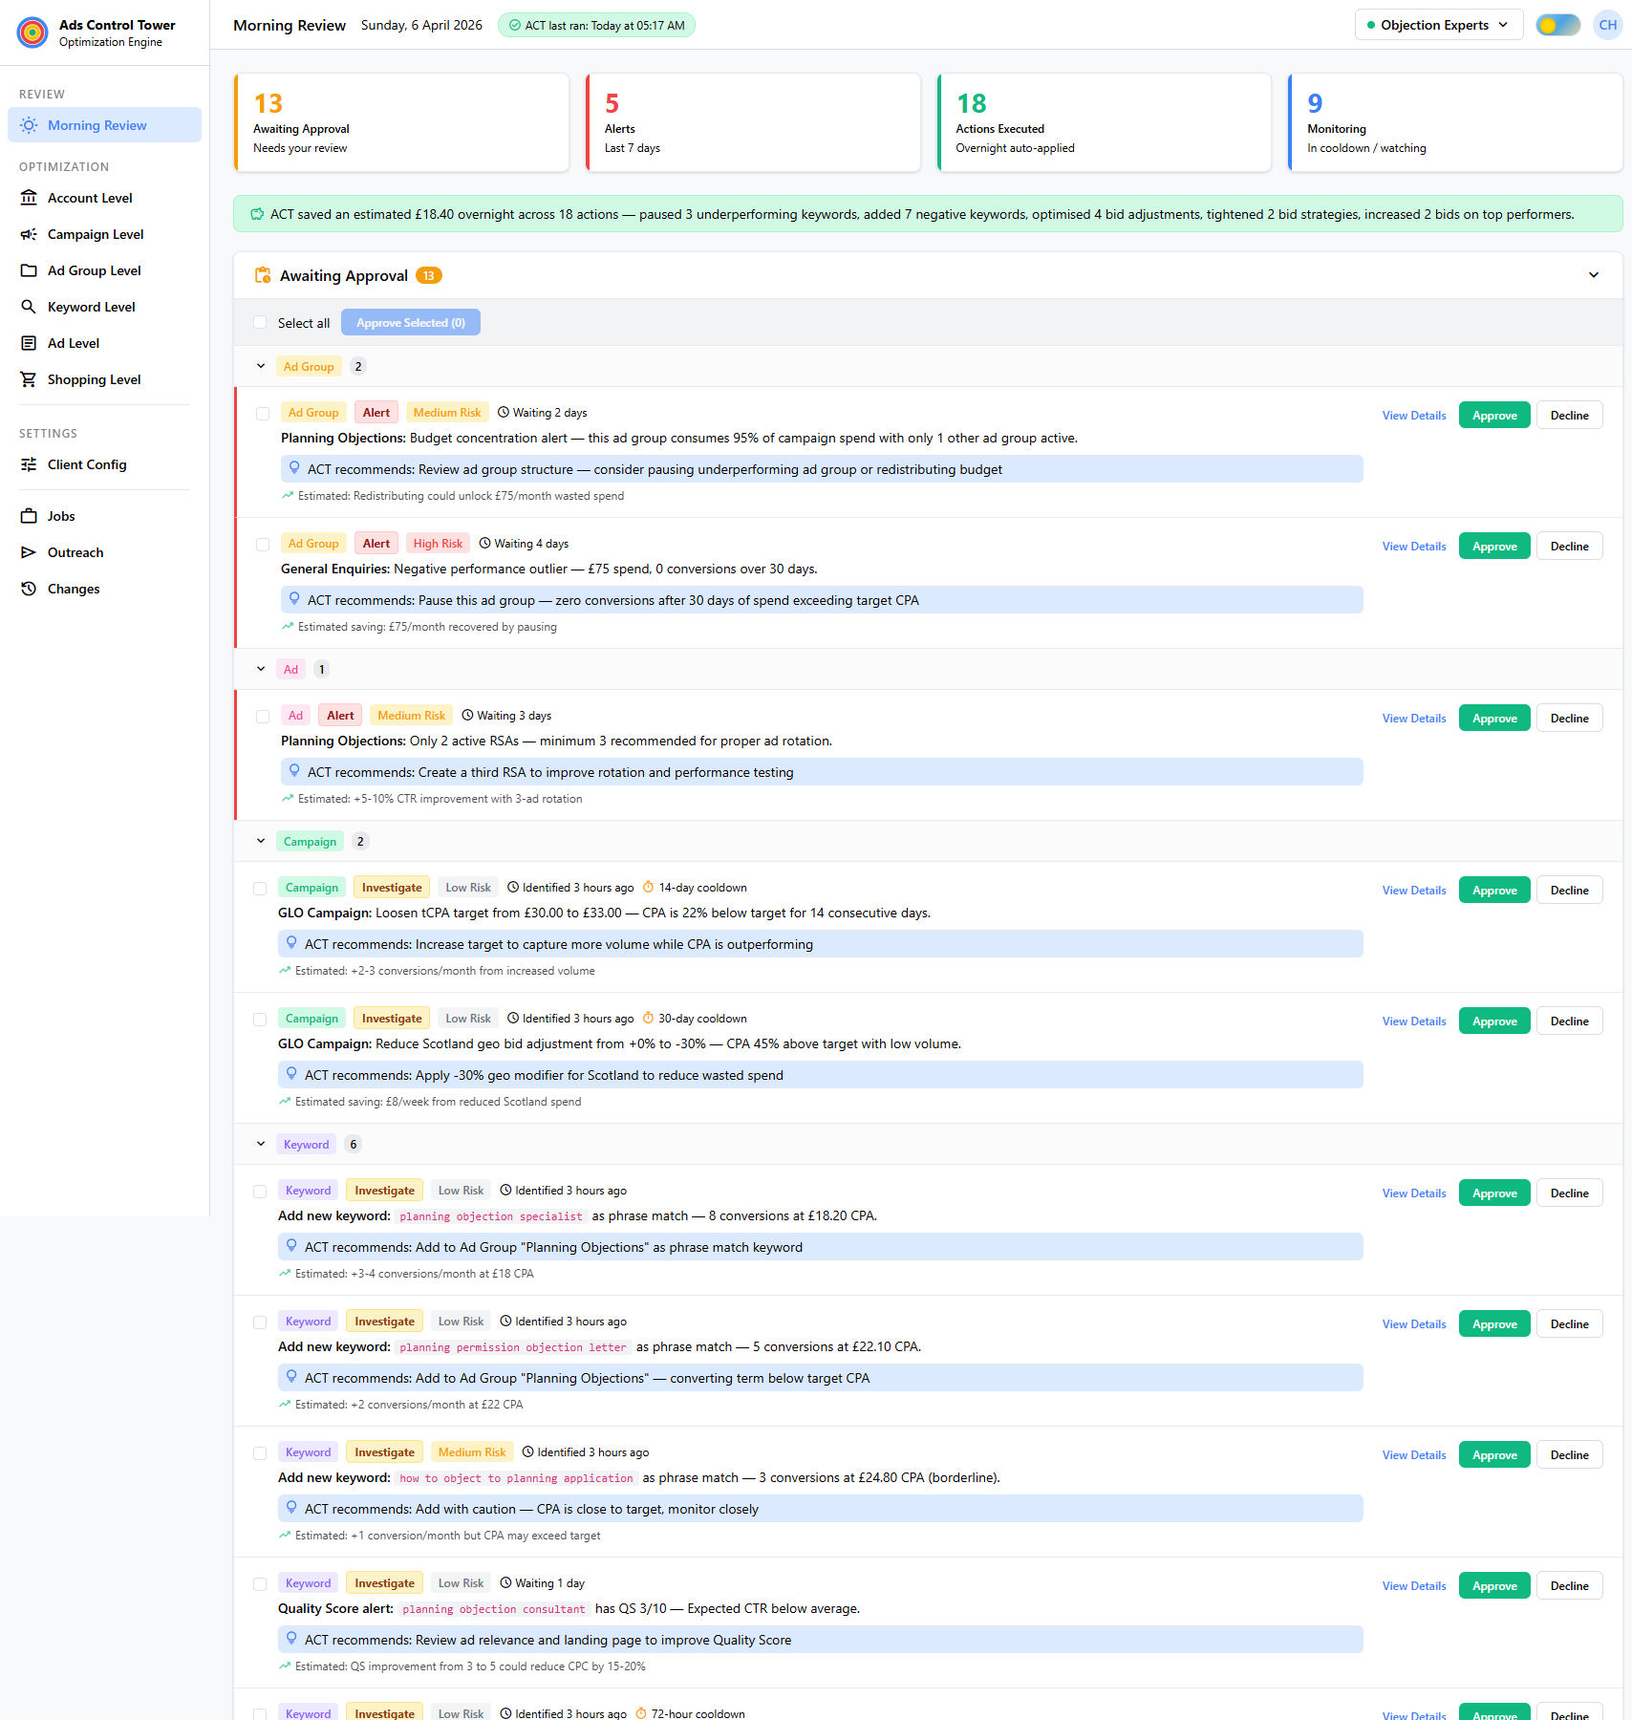
ACT — My Competitive Edge
Proprietary Platform
A proprietary Google Ads optimization engine I built from the ground up
What ACT Does
ACT Morning Review Dashboard
30+ automated checks — running overnight across Account, Campaign, Ad Group, Keyword, Ad, and Shopping levels
7 bid strategy rule sets — covering Manual CPC, tCPA, tROAS, Max Conversions, Max Clicks, PMax, and Shopping
9 negative keyword lists — auto-sorted by word count and match type — systematic protection against wasted spend
“Your campaigns are being optimised 24/7, not just when I log in. Every action is logged, explainable, and reversible. No other candidate has built their own optimization platform.”
Christopher Hoole | christopherhoole.com | Confidential
9

Slide 10
Why Me
Summary
1
Hands-on specialist — I work inside the platforms daily, not a strategist who delegates.
2
Direct dental and aesthetics PPC experience — same market, same dynamics.
3
Built my own Google Ads optimization platform (ACT) — no other candidate has this.
4
Proven audit methodology — 42.7% waste found, CPA reduced 35-48%.
5
I measure success by patient bookings, not clicks.
Christopher Hoole | christopherhoole.com | Confidential
10

Slide 11
Ready to Start Immediately
Christopher Hoole
Next Steps
chris@christopherhoole.com
christopherhoole.com
+44 7999 500 184
1
Grant me access to your Google Ads and Meta accounts
Read-only access is all I need to run the full audit
16 Years
Dental PPC
ACT Engine
I'll deliver a full audit report within the first week
Hands-On Experience
Direct Experience
Proprietary Platform
2
Waste analysis, structure review, and restructure plan
“I don't just manage campaigns. I've built a system to continuously optimise them. I have direct dental PPC experience. And I'm ready to start immediately.” — Christopher Hoole
3
You'll see measurable improvements within 30 days
Quick wins in week 1, structured optimization months 1-3

